Slide 1


Department of Information Science and Engineering
Department of Information Science and Engineering
Assisting people with dementia using Deep Learning
Aman Aftab (INT20IS016)
Ms Priyanka K (Assistant Professor)
Sumanth Kamath (INT20IS172)
Vikas Benhur Chitla (INT20IS186)
Date
11th Decemeber 2023

Slide 2
Contents
Software Requirement Specification(functional and non functional requirements)
Design consisting of, (with explanation)
Architectural Diagram
Block diagram
Flow Chart
Implementation
Algorithm
important code snippets
Project Progress Report Timeline

Slide 3
Functional Requirements
Hardware Requirements
User Registration and Profile Management
Memory Support
Cognitive Exercises
Communication Tools
Monitoring and Safety Features
2. Software Requirements
TensorFlow
Pandas
Firebase
Scikit-learn
GPT-3 (OpenAI)
NumPy

Slide 4
Non-Functional Requirements
Usability
Performance
Security and Privacy
Compatibility

Slide 5
Architectural Diagram
Humanoid AI with LLM capabilities engages patients in conversation.
Emotion detection module analyzes conversation for anger and adjusts prompts accordingly.
Brain games module proposes and schedules playful brain games based on patient preference and engagement.
Memory database stores family-provided memories for the LLM to access and incorporate into conversation.
Topic tracker identifies patient interests and periodically introduces related conversation topics.
Meal reminder assists with maintaining healthy eating habits.
Continuous learning

Slide 6
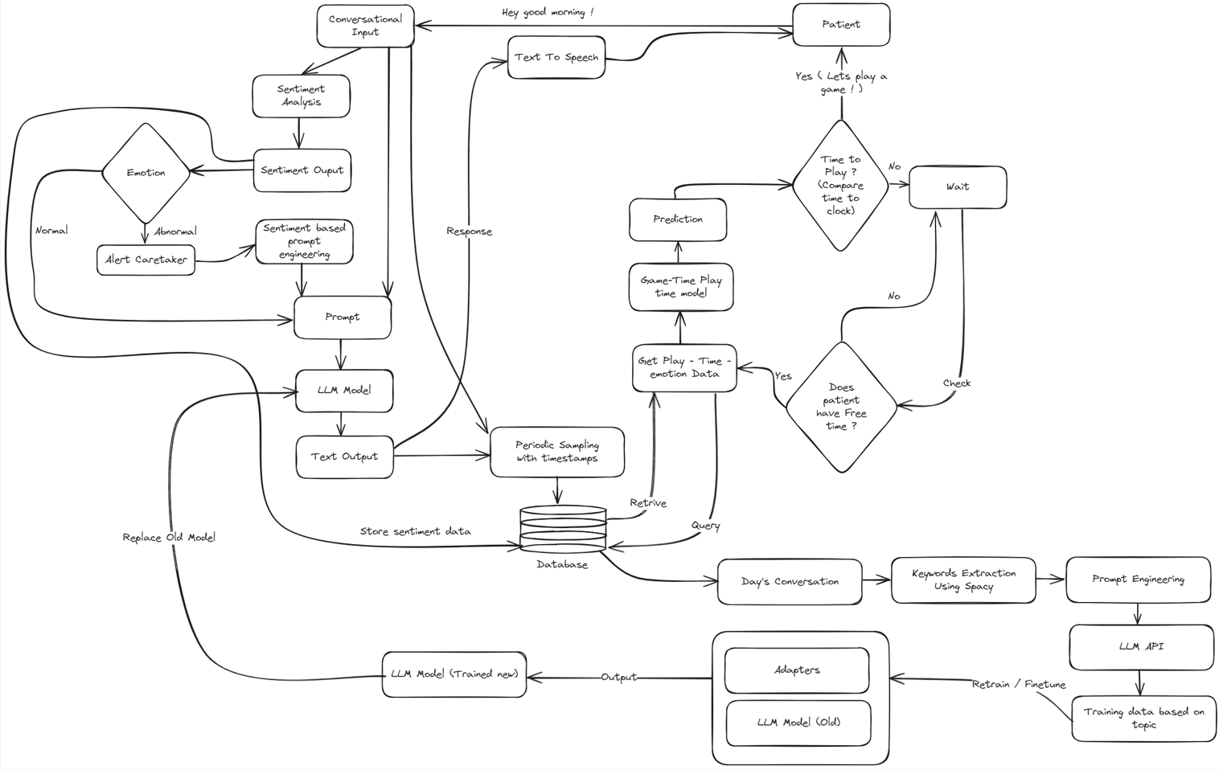
Architectural Diagram
.

Slide 7
Block Diagram
Conversation initiation
Anger detection
Conversation adjustment
Brain games
Memory reminiscing
Topic exploration
Meal reminders
Continuous learning

Slide 8
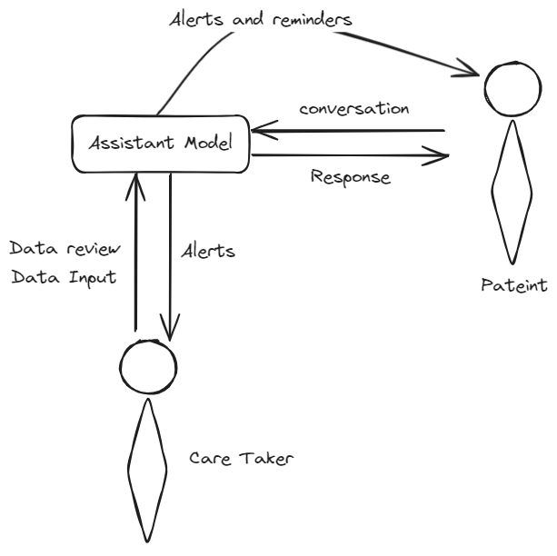
Block Diagram
.

Slide 9
Flow Chart LLM
Patients interact with the conversational AI through the patient interface.
The conversational AI uses data from the database to understand the patient's needs and generate a response.
The conversational AI may also generate cognitive game prompts for the patient.
The patient plays the cognitive games, and their progress is stored in the database.
Caretakers can view patient data and adjust game difficulty settings through the caretaker interface.
The model retraining module periodically retrains the conversational AI and adaptive cognitive game prompters using new data from the database.
The logging and monitoring module logs all system activity and monitors key metrics.

Slide 10
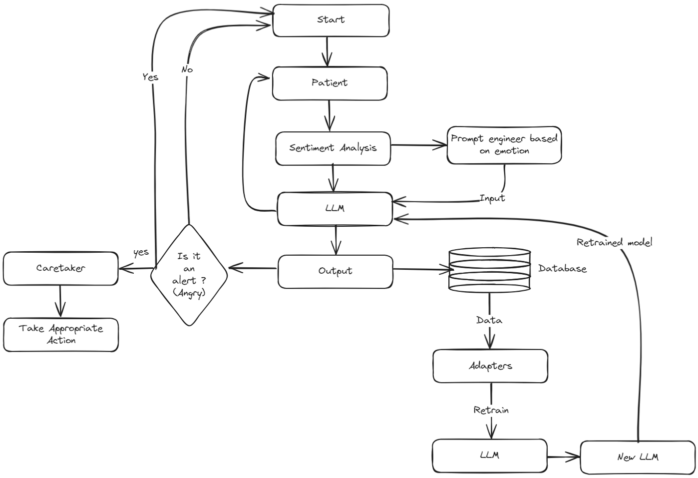
Flow Chart LLM
.

Slide 11
Flow Chart Game Implementation
The patient interacts with the conversational AI through the patient interface.
The conversational AI uses data from the database to understand the patient's needs and generate a response.
The conversational AI may also generate cognitive game prompts for the patient.
The patient plays the cognitive games, and their progress is stored in the database.
Caretakers can view patient data and adjust game difficulty settings through the caretaker interface.
The model retraining module periodically retrains the conversational AI and adaptive cognitive game prompters using new data from the database.
The logging and monitoring module logs all system activity and monitors key metrics.

Slide 12
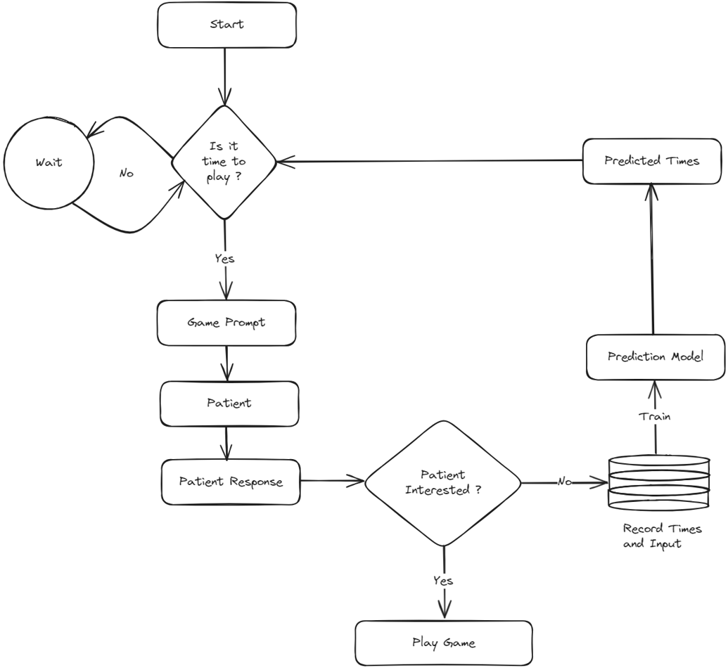
Flow Chart Game implementation

Slide 13
Algorithm
Conversation initiation:
Humanoid AI engages the patient in conversation using LLM capabilities.
Emotion detection module analyzes the conversation for signs of anger.
If anger is detected:
Adapt conversation prompts to be more caring and supportive.
Offer calming activities or suggest taking a break.
If no anger is detected, continue conversation as usual.
Brain games:
Periodically propose brain games that match patient preferences and abilities.
Adjust game difficulty and frequency based on patient engagement and performance.

Slide 14
Algorithm
Memory reminiscing:
Access patient-specific memories from the database.
Incorporate these memories into conversation to promote reminiscing and emotional connection.
Topic exploration:
Based on tracked interests, introduce new conversation topics related to current fascinations.
Gather new information about evolving interests.
Meal reminders:
Remind patients of scheduled meal times.
Track food intake to prevent overeating or malnutrition.
Continuous learning:
Use patient interactions and feedback to improve conversation models and personalize experiences.
Refine brain games and memory prompts based on patient preferences and performance.

Slide 15
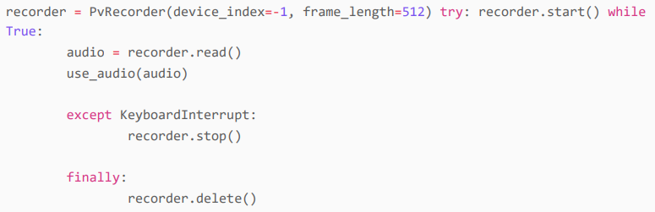
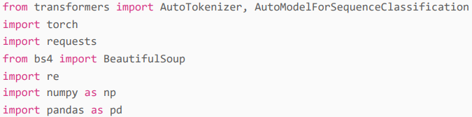
Important Code Snippets
Record Patient’s Conversation 2. Sentiment Analysis

Slide 16
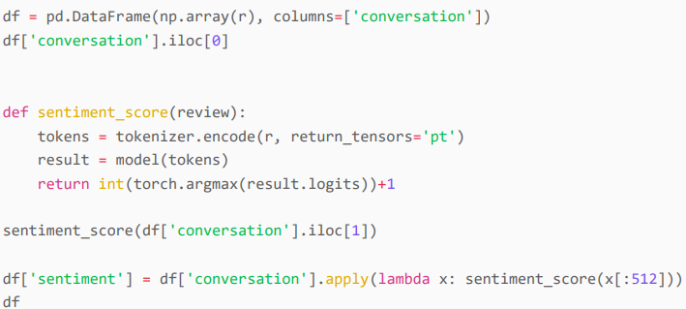
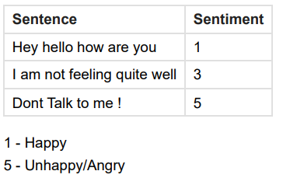
Important Code Snippets
3. Load Reviews into DataFrame and Score
Get the most probable Sentiment.
Store it in the DataFrame for later use.

Slide 17
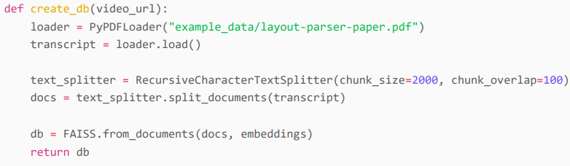
LLM Code Snippet
Similarity Search FAISS
Getting Responses
Take the created vector, that we had created prior.
Define the maximum number of batched you would want to use
Now, take the conversation or sentence the patient has given.
Then perform the similarity search using FAISS, using the data we have, for k batches.

Slide 18
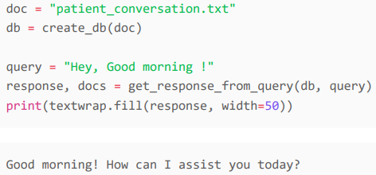
Getting Responses
Then combine all the information into one line.
Define the model you want to use.
Then create a predefined prompt, for the model to give the appropriate result.
Create a chain with the prompt
Run the query
Get the Response.
Get_response from_query is defined.

Slide 19

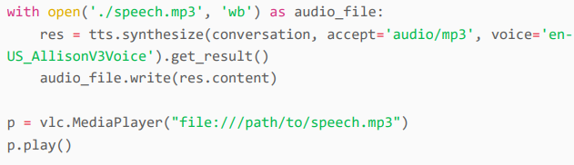
Text To speech Using watson from IBM
IBM Watson Text to Speech is an API cloud service that enables you to convert written text into natural-sounding audio.
Setup Service
Convert with A Language Model

Slide 20
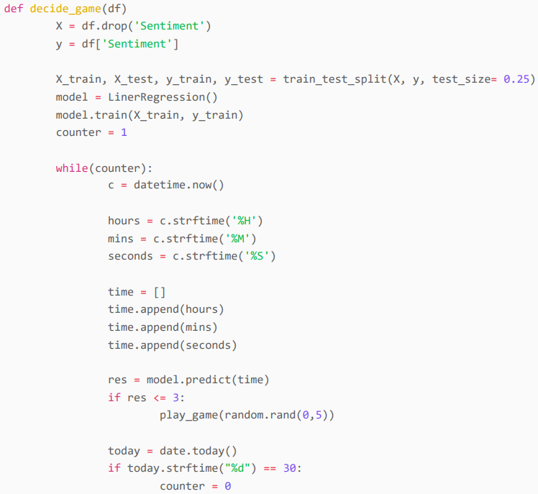
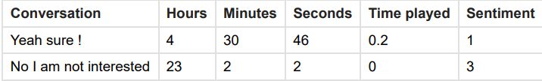
Game Implementation
1. Get the conversation and the timings
We prompt the patient, asking if he/she wants to play a game
Use a Linear regression model to predict values on what times the patient would want to play
At the end of every month we take the average time the patient spent and have a prompt asking if the patient wants to take a rest for the model to learn.

Slide 21

Thank you

